Slide 1

FYP MANAGEMENT SYSTEM
Aaron Lee

Slide 2
Outline
Limitation of the Current FYP Management System
Structure of the Overall Management System
Design for the Recommender System
Project Planning
Further Development

Slide 3
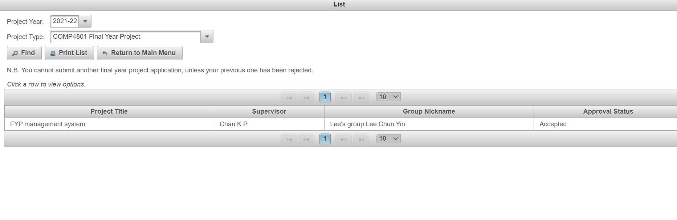
Current FYP Management System
Figure 1 – Current FYP Management System
3

Slide 4
Objectives of the Management System
handle project selection
presentation scheduling
handle project allocation

Slide 5
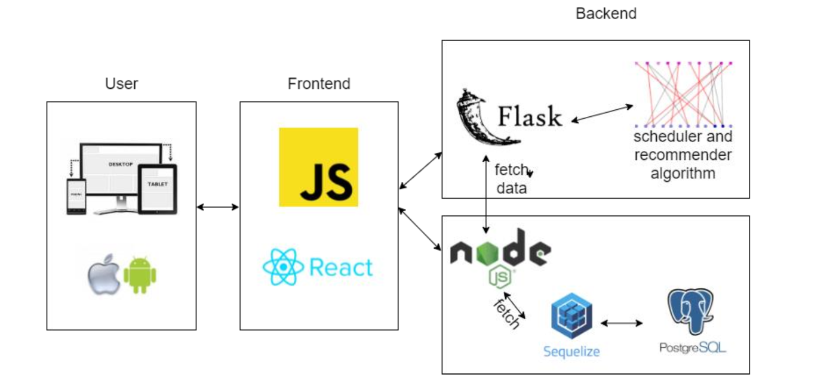
Architecture of the System
Figure 2 – Design of the FYP Management System

Slide 6

Frontend(ReactJS)
Angular is using TypeScript
Using Virtual DOM(higher efficiency)

Slide 7



Backend Server and Database
Flask for handling the machine learning algorithm
NodeJS for handling basic API, such as login handling
We will use PostgreSQL for the database

Slide 8
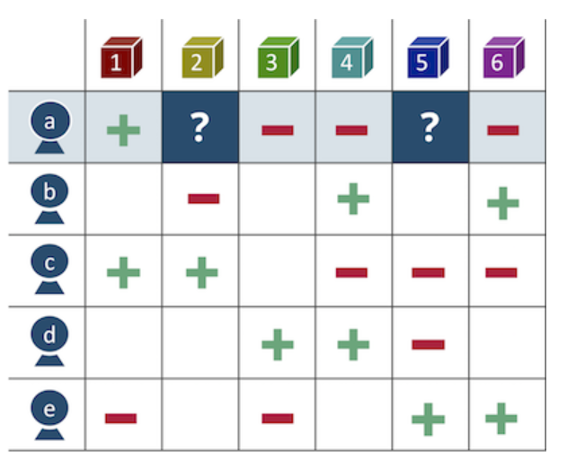
Recommender System

Slide 9
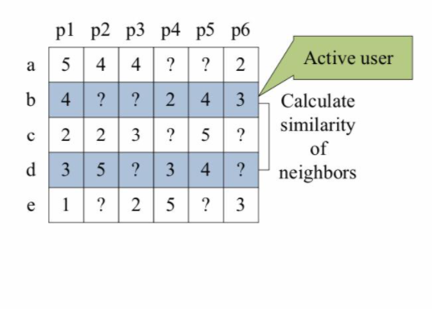

Collaborative Filtering
The formular we will use for calculating the similarity between the user

Slide 10
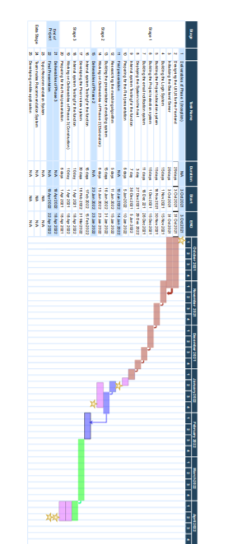
Gantt Chart(Project Planning)

Slide 11
Further Development
We will build the presentation scheduler in order to improve the productivity
Completing the recommender system
Creating the mobile platform for the users

Slide 12
References
Department of Computer Science, The University of Hong Kong. (2018). FYP Management System. Retrieved from https://intranet.cs.hku.hk/fypappl/.
Facebook. (2021). React native · learn once, write anywhere. React Native. Retrieved September 30, 2021, from https://reactnative.dev/.
Gad, A. F. (2020). Python genetic algorithm! ¶. PyGAD. Retrieved October 26, 2021, from https://pygad.readthedocs.io/en/latest/.
Hug , N. (2015). K-NN inspired algorithms¶. k-NN inspired algorithms - Surprise 1 documentation. Retrieved October 26, 2021, from https://surprise.readthedocs.io/en/stable/knn_inspired.html#surprise.prediction_a lgorithms.knns.KNNBasic.
Jannach, D. (2012). Recommender systems: An introduction. Cambridge University Press.

